Slide 1
The OpenPET Firmware and Software Development
Qiyu Peng

Slide 2
Guidelines for firmware/software design
Stable and reliable
Flexible, compatible and scalable
Simple and easy to use
Upgradable
Well-documented
Readable and maintainable

Slide 3
System-level hardware structure

Slide 4
System-level firmware and software structure

Slide 5
Programming Tools / Environment
 | DB | DUC | MB | CUC | Host PC
FPGA Firmware | X | X | X | X
Embedded MCU Software (NIOS) |  | X | X | X
PC Software |  |  |  |  | X
X: VHDL (Altera Quartus II ver. 12.0)
X: C (Altera Nios II EDS ver. 12.0)
X: C (NI LabWindows CVI 2009)

Slide 6
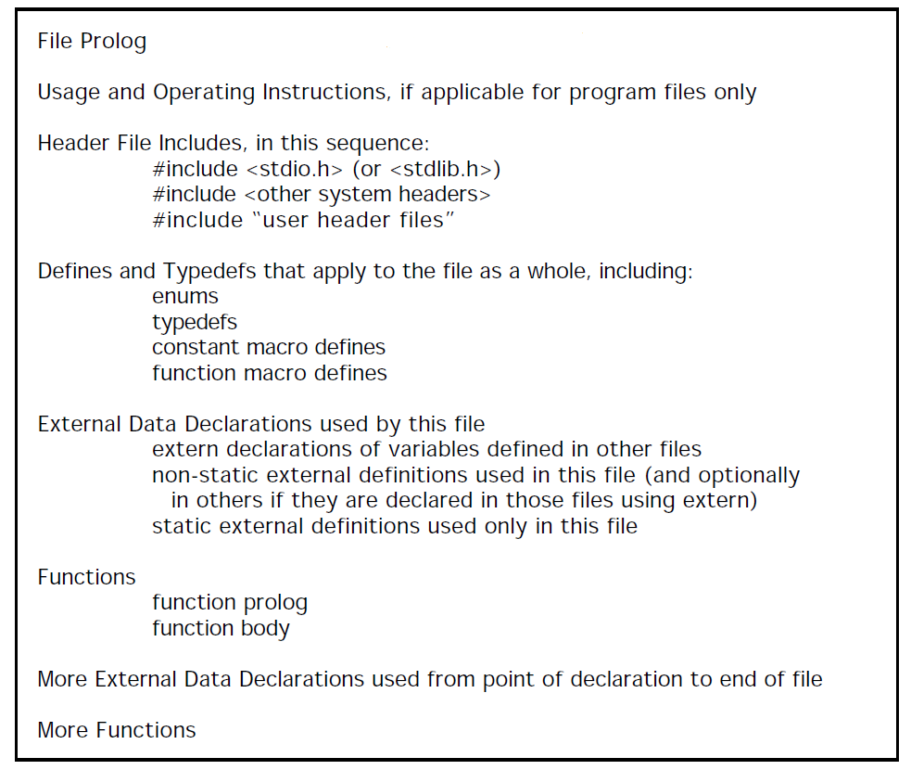
C programing style guidelines
Rules and guidelines are used to guarantee the readability and maintainability of the C source codes (details are in my word file)
Based on “C Style Guide” suggested by Software Engineering Laboratory (SEL), the National Aeronautics and Space Administration (NASA) in 1994.

Slide 7
C programing style guidelines
Doxygen JavaDoc style documentation generated from “OpenPETexampleCStyle.c”.

Slide 8
C programing style guidelines
Doxygen JavaDoc style documentation generated from “OpenPETexampleCStyle.c”.

Slide 9
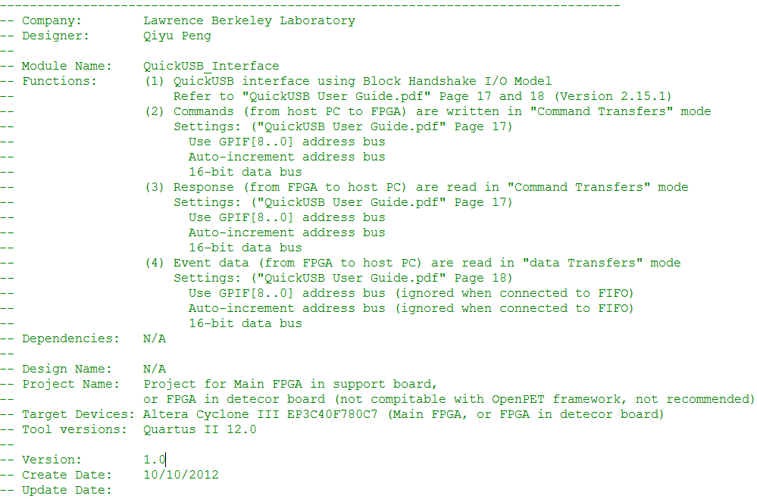
VHDL programing style guildlines
12 rules and 14 guidelines are used to guarantee the readability and maintainability of the VHDL source codes (details are in my word file)
OpenPET VHDL program Style template for file prolog
Rules and guidelines are developed from Coding Style Guidelines suggested by Xilinx and Altera

Slide 10
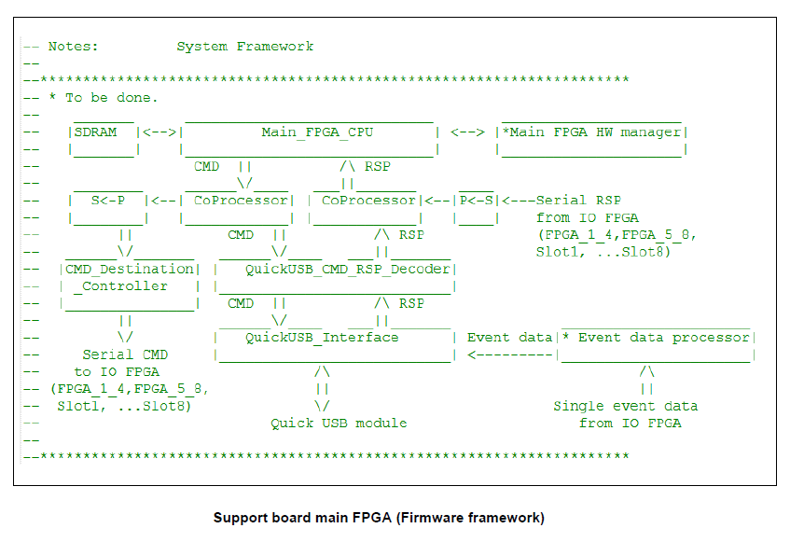
OpenPET VHDL program Style template for file prolog, Modular design

Slide 11
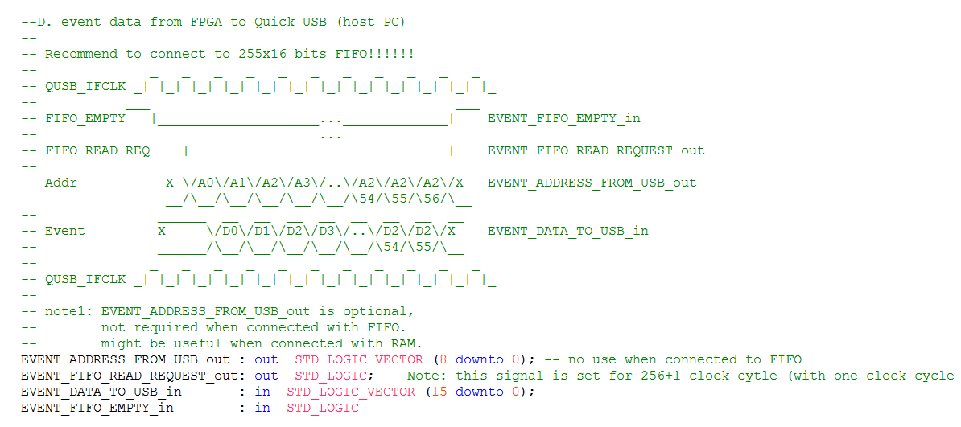
OpenPET VHDL program Style template for file prolog, timing diagram of input and output
http://users.eecs.northwestern.edu/~seda/coding_guidelines_013003.pdf
http://www.cs.tut.fi/~ege/Misc/dcs_vhdl_coding_rules_es_v4_4.pdf
http://www.altera.com/literature/hb/qts/qts_qii51007.pdf

Slide 12
Host PC software
Modular Design
Simple and easy to use
Upgradable
Main Functions
System configuration
System diagnosis
Data acquisition
Data analysis

Slide 13
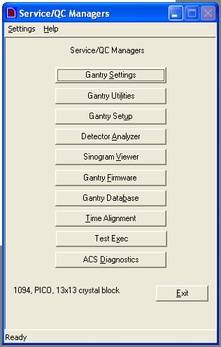
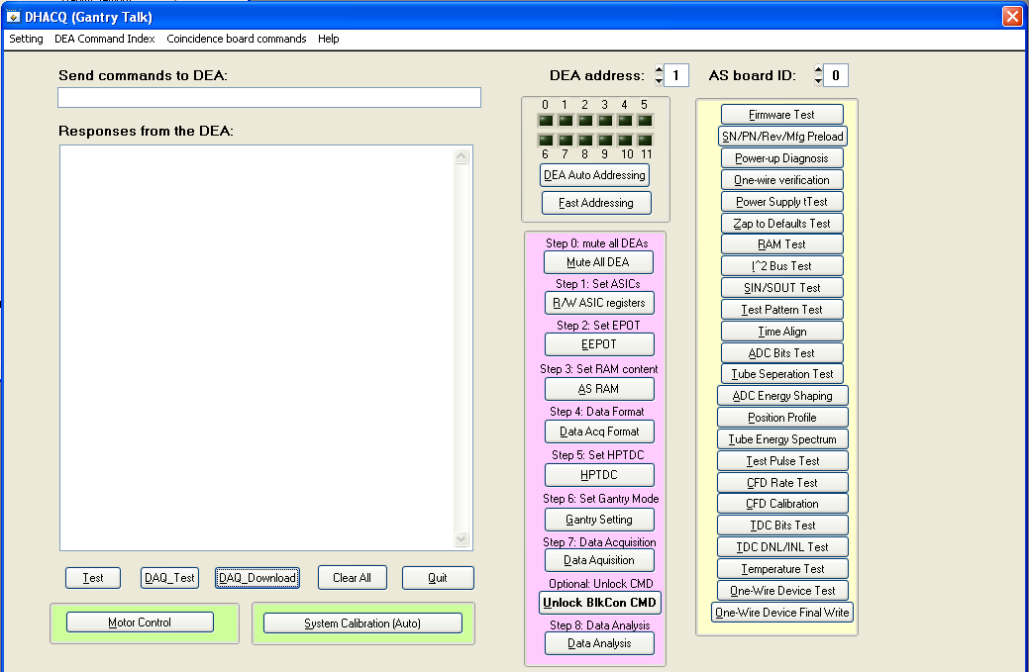
Graphical User Interface (GUI) design
Top level design

Slide 14
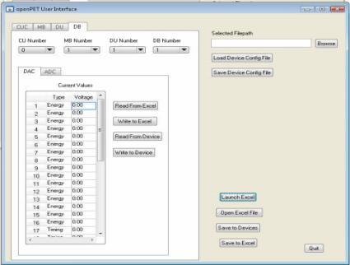
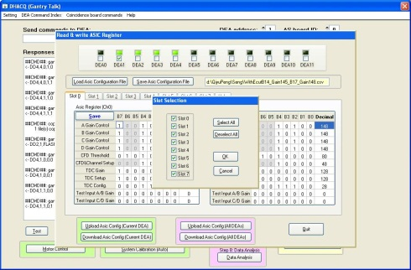
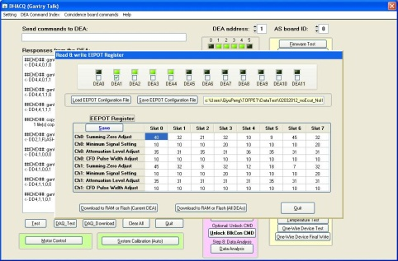
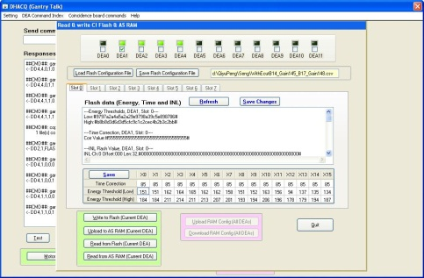
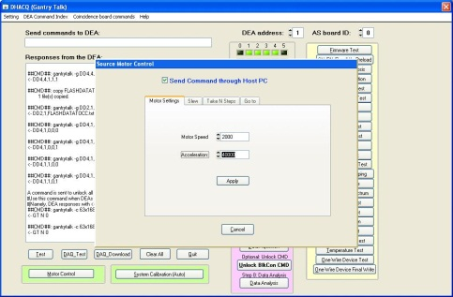
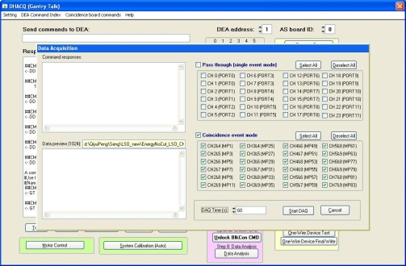
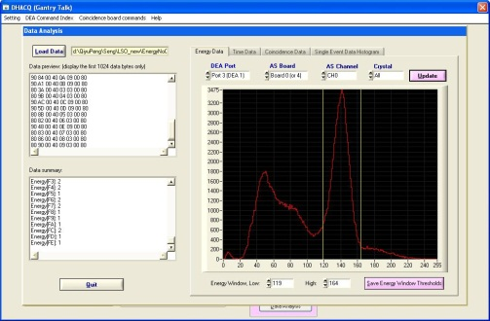
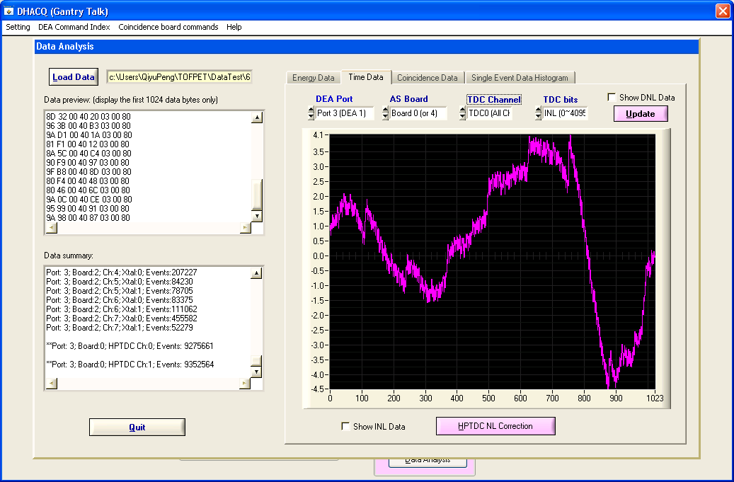
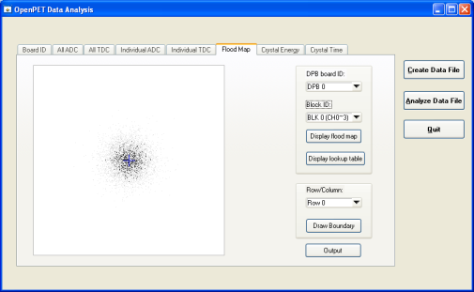
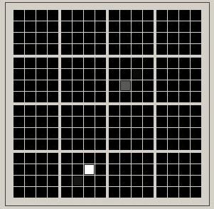
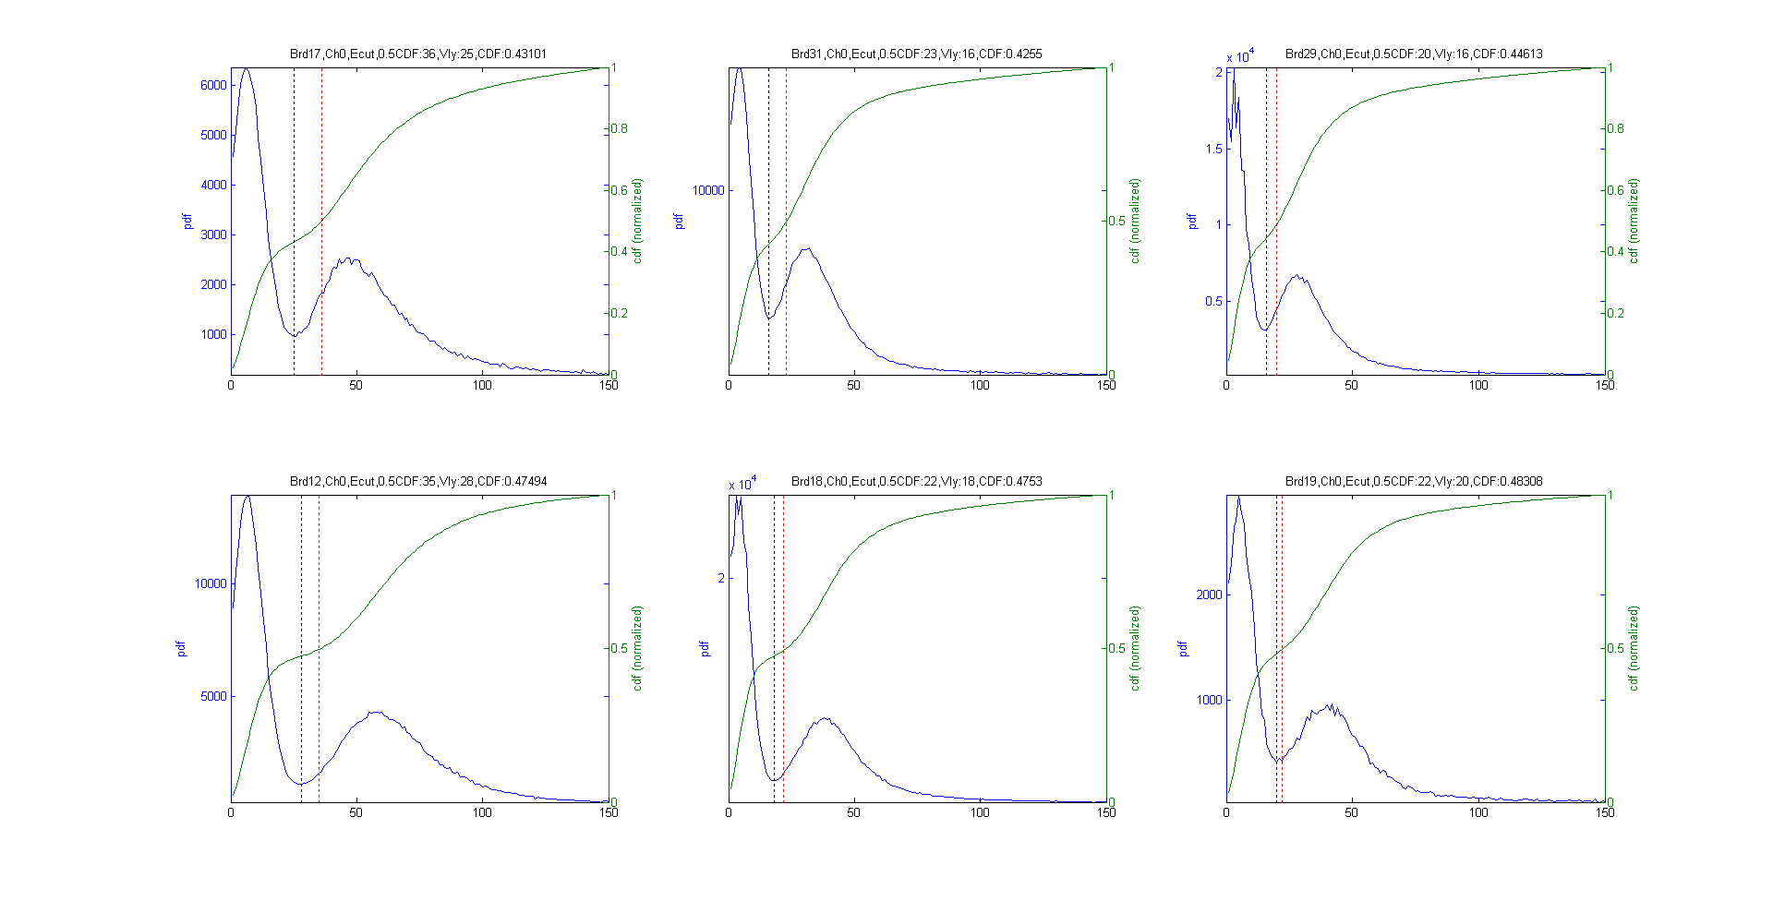
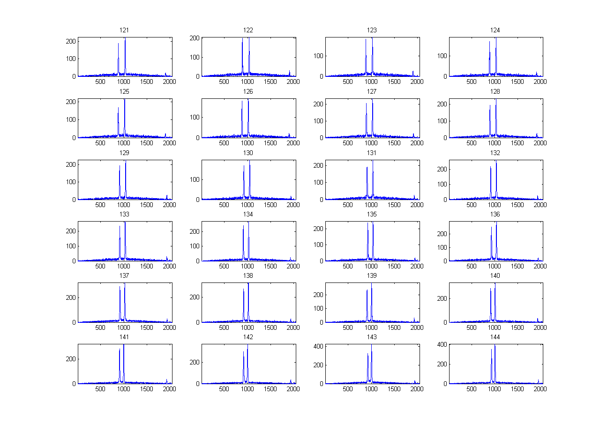
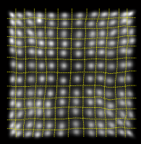
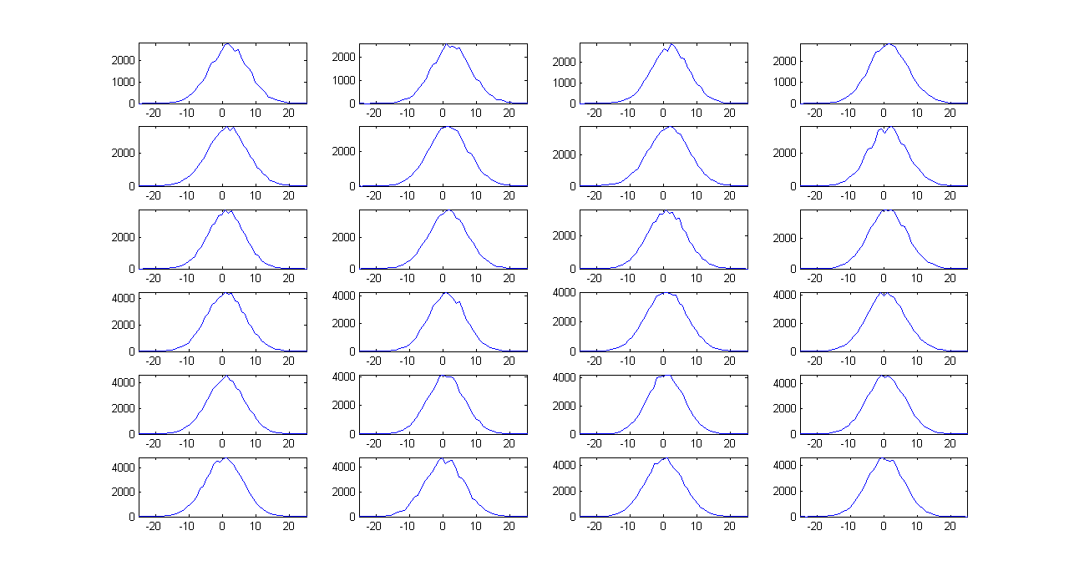

Graphical User Interface (GUI) design
System configuration database management
Analog gain settings
CFD settings
Energy window settings
Serial communication
Data acquisition
Energy data analysis
TDC calibration
Chinh Vu and Michael Malus also contributed to the GUI design
Crystal decoding
Delay compensation
Time analysis
Sinogram analysis
Flood map display
(for block detector)
Data analysis SW package
(currently in Matlab)
SSPM event display

Slide 15
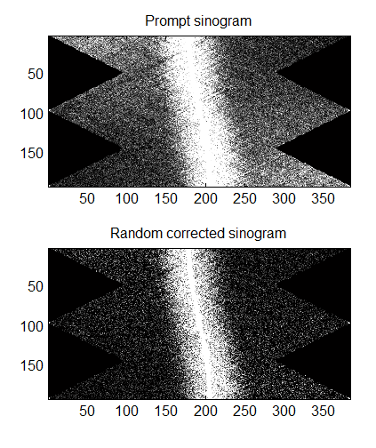
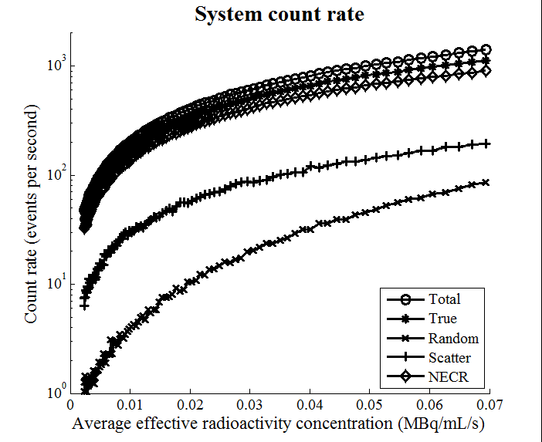
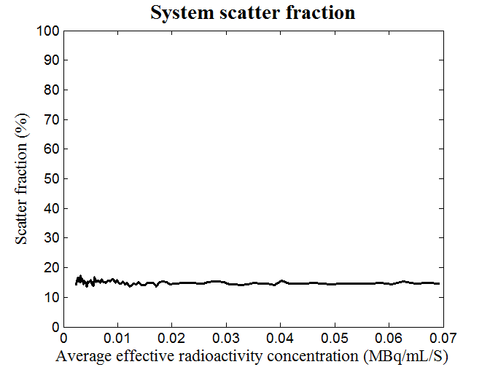
Graphical User Interface (GUI) design
System characterization

Slide 16
Nios software
Modular design
Simple and easy to use
Upgradable
Main Functions
System configuration
System monitoring
System diagnosis

Slide 17
Firmware function and framework
DB firmware
CUC/MB/DUC/CDUC firmware

Slide 18
Event words and status words
In general, there are two kinds of words in the OpenPET list mode data:
Event words, include
-- Single event words, and
-- Coincidence
Status words transmit information other than the event data to the host PC, such as:
-- Event data format
-- Time information
-- Single or coincidence event rate
-- System configuration and status
-- Application-specific information such as patient bed position, transmission source position, system temperature, ECG signal, gate signal and etc.

Slide 19
Event words
Event word path
Add 3-bit MB address to single event data.
Generate coincidence event data (optional).
Insert status words to the data stream.
Generate original single event data
Add 3-bit DB
address to the
single event data
Add 3-bit DUC
address to the
single event data
Host PC
DB
DUC
MB
CUC
Add 3-bit DB address to single event data.
Generate coincidence event data (optional).
Insert status words to the data stream.
Generate original single event data
Host PC
DB
CDUC
Add 3-bit DUC address to single event data.
Generate coincidence event data (optional).
Insert status words to the data stream.
Generate original single event data
Add 3-bit DB
address to the
single event data
Host PC
DB
DUC
CUC

Slide 20
Event data length
Data from DB→DUC, DUC→ MB and MB→CUC
Single event data only
32-bit mode or 64-bit mode.
Data from CUC → host PC
Single event data, coincidence event data and status words.
32-bit mode, 64-bit mode, and 128-bit mode.

Slide 21
Data paths and data mode combinations
32 bits
32 bits
32 bits
32 bits
DB
DUC
MB
CUC
Host PC
8 system clocks
32 bits
32 bits
32 bits
64 bits
DB
DUC
MB
CUC
Host PC
64 bits
64 bits
64 bits
64 bits
DB
DUC
MB
CUC
Host PC
16 system clocks
64 bits
64 bits
64 bits
128bits
DB
DUC
MB
CUC
Host PC
Oscilloscope mode

Slide 22
DB→DUC, DUC→ MB and MB→CUC
32-bit data (8 system clocks)
General definition
1
MB address
DUC address
DB address
Block address
Crystal ID
31
30
29
28
27
26
25
24
23
22
21
20
19
18
17
16
Crystal ID
Payload
15
14
13
12
11
10
9
8
7
6
5
4
3
2
1
0

Slide 23
DB→DUC, DUC→ MB and MB→CUC
32-bit mode (8 system clocks)
Payload definition
-- Time mode – Bit 10~0, TDC data bits (11 bits, LSB: 50ps).
-- Energy mode – Bit 10~0, energy data bits (11 bits).
-- Test mode1 – Bit 10~0, test pattern data: 10101010101.
-- Test mode2 – Bit 10~0, test pattern data: 01010101010.
-- Anger-logic flood map plot mode – Bit 18, not used,
Bit 17~9, Y value (9 bits), Bit 8~0, X value (9 bits).
-- User-defined mode 1 - 11 bits of payload
-- User-defined mode 2 - 14 bits of payload
-- User-defined mode 3 - 17 bits of payload
-- User-defined mode 4 - 22 bits of payload
-- User-defined mode 5 - 25 bits of payload
-- User-defined mode 6 - 28 bits of payload
Standard
User-defined

Slide 24
DB→DUC, DUC→ MB and MB→CUC
32-bit mode (Oscilloscope mode)
General definition
1
MB address
DUC address
DB address
Channel address
Unused
31
30
29
28
27
26
25
24
23
22
21
20
19
18
17
16
Data counter
Raw ADC data
15
14
13
12
11
10
9
8
7
6
5
4
3
2
1
0
The maximum length of the raw data train is 64

Slide 25
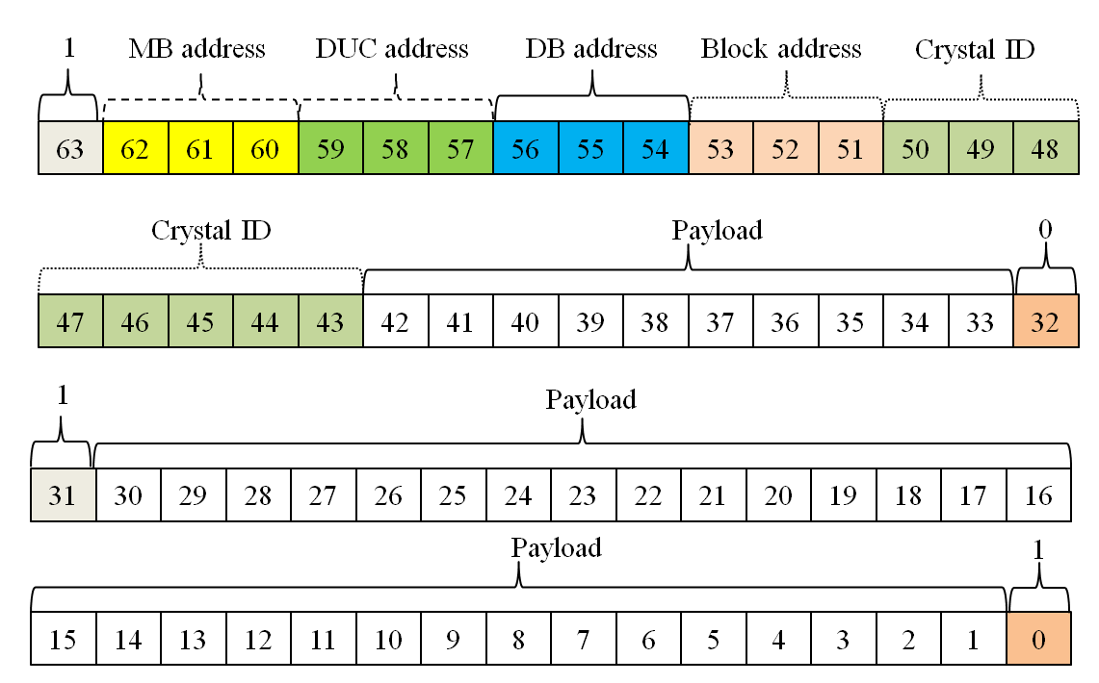
DB→DUC, DUC→ MB and MB→CUC
64-bit data (16 system clocks)
General definition

Slide 26
DB→DUC, DUC→ MB and MB→CUC
32-bit mode (8 system clocks)
Payload definition
-- Time mode – Bit 10~0, TDC data bits (11 bits, LSB: 50ps).
-- Energy mode – Bit 10~0, energy data bits (11 bits).
-- Test mode1 – Bit 10~0, test pattern data: 10101010101.
-- Test mode2 – Bit 10~0, test pattern data: 01010101010.
-- Anger-logic flood map plot mode – Bit 18, not used,
Bit 17~9, Y value (9 bits), Bit 8~0, X value (9 bits).
-- User-defined mode 1 - 11 bits of payload
-- User-defined mode 2 - 14 bits of payload
-- User-defined mode 3 - 17 bits of payload
-- User-defined mode 4 - 22 bits of payload
-- User-defined mode 5 - 25 bits of payload
-- User-defined mode 6 - 28 bits of payload
Standard
User-defined

Slide 27
CUC → host PC
Single event mode
In single event data mode (including the 32-bit raw ADC data mode), the formats of the data from CUC/CDUC→ host PC are the exactly the same that those defined in previous section (DB→DUC, DUC→ MB and MB→CUC).

Slide 28
CUC → host PC
Coincidence event mode
Two 32-bit single event data → one 64-bit coincidence event data
Two 64-bit single event data → one 128-bit coincidence event data
Two 32-bit single event data → one 32-bit coincidence event data
Two 64-bit single event data → one 64-bit coincidence event data
1
MB address
DUC address
DB address
Block address
Crystal ID
63
62
61
60
59
58
57
56
55
54
53
52
51
50
49
48
Single Event 1
Crystal ID
Payload
47
46
45
44
43
42
41
40
39
38
37
36
35
34
33
32
Valid
MB address
DUC address
DB address
Block address
Crystal ID
31
30
29
28
27
26
25
24
23
22
21
20
19
18
17
16
Single Event 2
Crystal ID
Payload
15
14
13
12
11
10
9
8
7
6
5
4
3
2
1
0

Slide 29
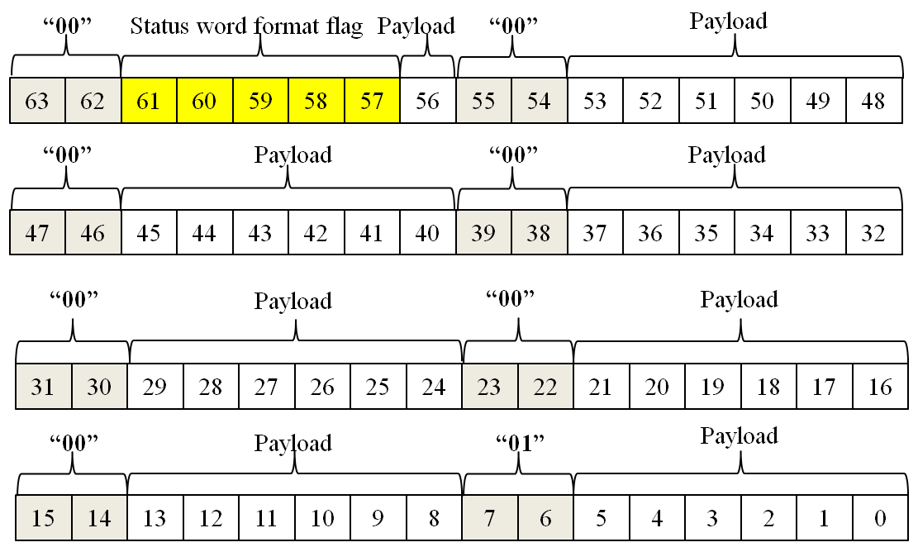
Status word (fixed to 64 bits)
General definition

Slide 31
Branches in 64-bit list mode data file
64 bits data format
Bit63=0, coincidence data
Bit63=1, not coincidence data
Bit62=0, default data format
Bit62=1, User-defined data format
Bit62=1, single event data format
Bit62=0, status data format
Bit61~58=0000, time mode data
Bit61~58=0001, energy mode data
Bit61~58=0010, raw ADC data
Bit61~58=0011, Anger logic data
Bit61~58=0100, Test mode1 data
Bit61~58=0101, Test mode2 data
Bit61~58=0110~1010, reserved
Bit61~58=1011~1111, user-defined
Bit61~57=00000, time status word
Bit61~57=00001, event rate status word
Bit61~57=00010, temperature status
Bit61~57=00011~10000,reserved
Bit61~57=10001~11111, user-defined

Slide 32
Algorithm to decode list mode data file
Start
Read 8 bytes of data
Check the two MSB of the 8 bytes of data
Find pattern “00”, …, “01”?
No
Yes
No
An event format status word (00000)?
Yes
Determine the event data format
End

